Slide 1
MOBILE APP DEVELOPMENT
Kotlin Programming
Dr. Baoqiang Yan

Slide 2

WHAT YOU SHOULD KNOW…
Modern Programming Language
OOP – Object Oriented Programming
Classes, Inheritance, Polymorphism, Interface, Methods/Functions, Exception Handling, etc.
Statically Typed (not changeable)
Have programmed for some time
IDE – IntelliJ or Android Studio

Slide 3
INTRODUCING KOTLIN
Started by JetBrains in 2011, open sourced in 2012 and officially supported by Google for Android OS in 2017
Concise syntax, modern features and seamless interoperability with legacy Java code
A general-purpose programming language for many platforms and usages including Android programming.
Supposedly to replace Java for Android Dev

Slide 4
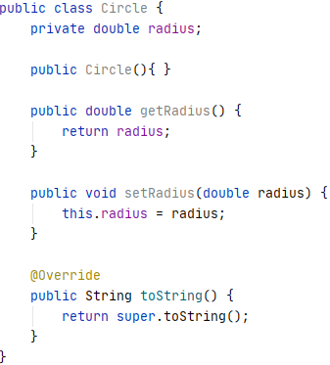

JAVA VS. KOTLIN
Much less boilerplate code
Kotlin Documentation
Java Code
Kotlin Code

Slide 5
YOUR FIRST KOTLIN
APPLICATION
Installing JDK
Installing IntelliJ IDEA Community, then update
https://www.jetbrains.com/idea/download/#section=windows
https://kotlinlang.org/docs/jvm-get-started.html
Output in the Run window at the bottom
fun main(args: Array<String>){
println("Hello World!")
}

Slide 6
COMPILE AND RUN KOTLIN ON
COMMAND LINE
Add the kotlinc bin to system path
  Find kotlinc bin path in the IntelliJ installation folder.
  Paste it in system path
  Control Panel\System and Security\System
  Advanced system settings > Environment Variabls … > System variables > Path > Edit > New then paste
Compile and run
kotlinc Hello.kt //two files generated
kotlin HelloKt [args] //not Hello.kt

Slide 7
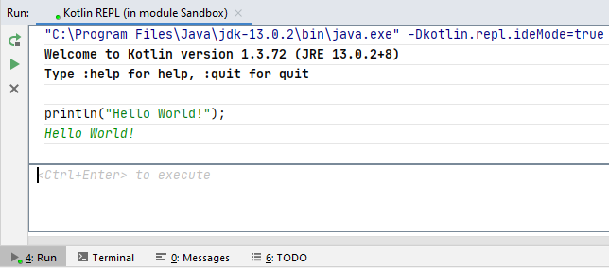
KOTLIN REPL
(RUN-EVAL-PRINT LOOP)
Tools > Kotlin > Kotlin REPL

Slide 8
VARIABLES, CONSTANTS,
AND TYPES
Variables
var varname: type = initial value
Constants
[const] val CONST_NAME: type = const value
Types (Static, Explicit vs. Inference) Ctrl+Shift+P
Numbers – Byte, Short, Int, Long, Float, Double
Boolean – true, false
Characters & Strings
List, Set & Map

Slide 9
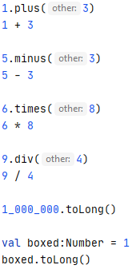
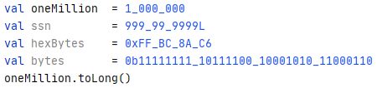
PRIMITIVES AS OBJECTS
You can call functions on primitive values/variables.
Implicitly the primitive data is boxed.
_ can be used to make number more readable.

Slide 10


NO IMPLICIT TYPE PROMOTION
explicit type casting required

Slide 11
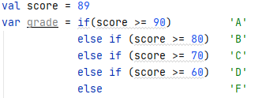
CONDITIONALS
if/else [if] Statements
== vs. != for value comparison
=== vs. !== for reference comparison
Logical operators
! < && > || example: ! false && false
false && true || true
Conditional expressions in assignment

Slide 12
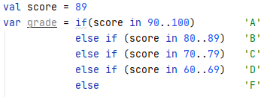
RANGES
.. for ranges
Number range: 5 in 3..10
6.5 in 3.4..10.23
Character range: ‘c’ in ‘a’..’z’

Slide 13
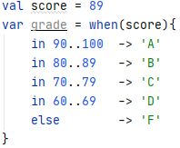
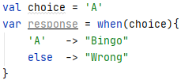
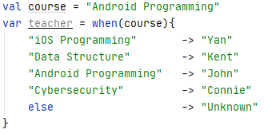
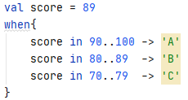
WHEN EXPRESSION
Check value against multiple cases
else is required to make exhaustive cases when used in a statement/expression
Else is not required if “when”
is used “alone”.

Slide 14
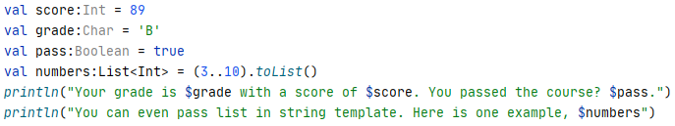
STRING TEMPLATES
The dollar sign $ before variable names within quotes
Output：

Slide 15


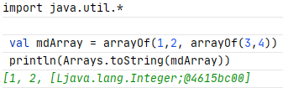
ARRAYS
Mixed array
Typed array：
Nested array：

Slide 16

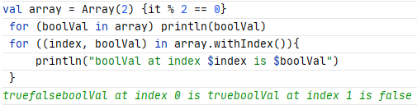

ARRAYS
Dynamically initialized array
Loop through an array：
Filtering an array：
REPL is not printing new lines.

Slide 17
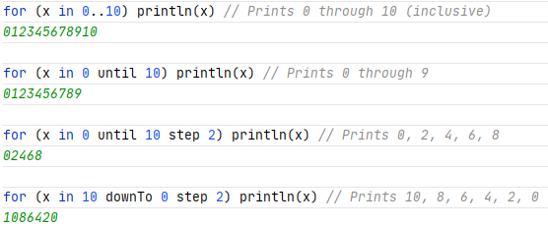
LOOPS
For loop through arrays (previous slide)
For loop through ranges
While loop same as in Java. All for loops can be converted to a while loop.

Slide 18


REPEAT
Perform the same operations for certain times.

Slide 19
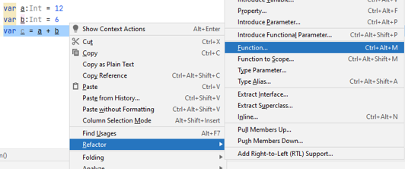
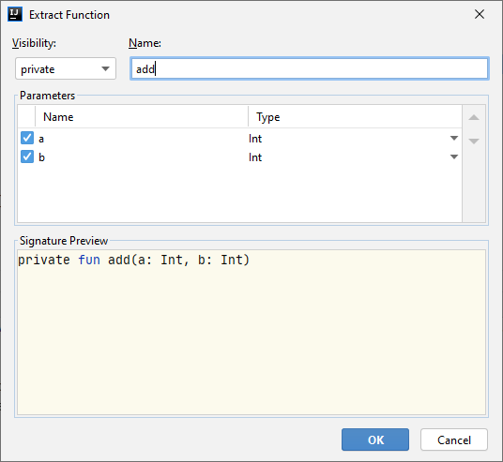
FUNCTIONS
Extracting Code to Functions
Function key word: fun

Slide 20


FUNCTIONS
Visibility modifiers
private public internal protected
Function name
fun name
Function parameters
name:type[, name:type]
Function return type – [:type] at the header end.
No return type ➔ Unit function
Function body and scope – { local variables …}

Slide 21




FUNCTION CALL &
DEFAULT ARGUMENTS
Default Arguments
name:type[=default_value] in parameter list
Function calls
Output:
Default values can be another variable or a function call
Named Arguments in a different order
Notes:
Try this slide’s code after refactoring the code into addInts function

Slide 22
SINGLE EXPRESSION
FUNCTIONS
Reduce the amount of code required for functions with one expression to return
Conditional expressions can be used too
Every expression has a value
To refactor to use expression for return, put cursor before { and press alt enter.
Notes:
Try this slide’s code after refactoring the code into addInts function

Slide 23


LAMBDAS – ANONYMOUS
FUNCTIONS
No function name – also called function literals
Must be defined in an existing named function
Implicit returns
May have local variables
Callable (but not after parenthesis)

Slide 24
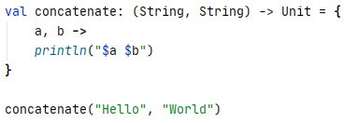
FUNCTION TYPE
Assign the anonymous function to a variable
This variable’s type is function (no “fun”)
  params – types in parenthesis, names in body then
  return type specified using instead of
  Unit type for no value return
Call this function via
the variable name

Slide 25

THE IT KEYWORD
it can be used to access the parameter when only one parameter is specified in anonymous functions.
No parameter name needed.

Slide 26
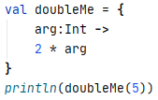
TYPE INFERENCE SUPPORT
No explicit type when defining function variable
Parameter types specified in function body
Return type inferred from returned value

Slide 27

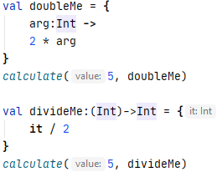
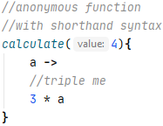
FUNCTION AS A PARAMETER
Parameter type same as function variable type
Different functions with the same parameter list and return type can be passed as an argument.
Function variables
lambda
Function reference – name of a regular function can also be used with ::

Slide 28


FUNCTION INLINING
Objects created when lambdas are called
Function inlining reduces memory overhead caused by lambdas.
Used in functions that takes functions as arguments
Allows return in lambdas for program control

Slide 29
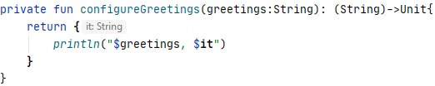

FUNCTION AS RETURN TYPE
Function type as return type after :
Lambda in return statement
Create a function variable and call

Slide 30


NULL SAFETY
Variables are non-nullable by default
Explicit null type via question mark ?
Non-null assertion via !! removes compile time error but not run-time error, if occurs.
Safe call operator – ?
You could compile it but will get a run-time error.

Slide 31
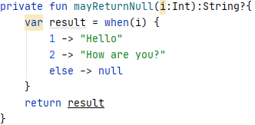
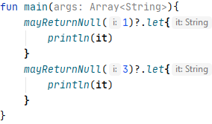
LET FUNCTION WITH THE
SAFE CALL OPERATOR ?
Automatically executed when the value is not null.
Not executed when the value is null.
Will print “Hello”
Not executed.

Slide 32

THE NULL COALESCING
(ELVIS) OPERATOR ?:
Automatically executed when the value is null.
Not executed when the value is not null.
Will print “Hello”
Will print “null returned”
Somewhat like a tertiary operator

Slide 33
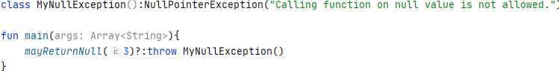
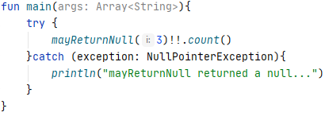
EXCEPTIONS
Will crash your program if not handled.
Throwing an exception when appropriate
Handling exception with try/catch
Throwing a Customized Exception
Handle exception with try/catch

Slide 34
PRECONDITION FUNCTIONS
checkNotNull function – throws an instance of IllegalStateException with custom message when the first argument is null.

Slide 35
PRECONDITION FUNCTIONS
require function – throws an instance of IllegalArgumentException with custom message when the first argument is false.

Slide 36
PRECONDITION FUNCTIONS
requireNotNull function – throws an instance of IllegalArgumentException with custom message when the first argument is null. Same as error.

Slide 37
PRECONDITION FUNCTIONS
assert function – throws an instance of AssertionError with custom message when the first argument is false.
Assertion needs to be enabled:
Run > Edit Configure > Put “-ea” in the VM options box > Apply

Slide 38
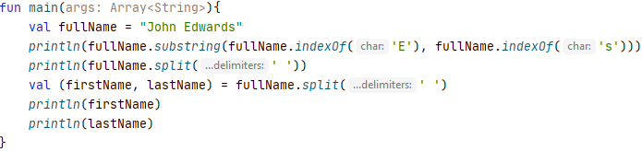
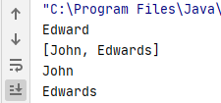
STRINGS
substring(start until end) – right exclusive
indexOf
split(delimiter) – overloaded fun
Destructuring – assign split values to variables

Slide 39
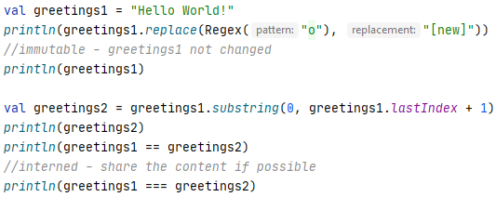
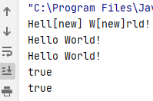
STRINGS
replace(Regex, Replacement)
– strings are immutable and interned (shared)
== or != – for content comparison
=== or !== – reference comparison

Slide 40

STRING TO NUMBERS
toFloat
toDouble toDoubleOrNull
toIntOrNull
toLong
toBigDecimal

Slide 41
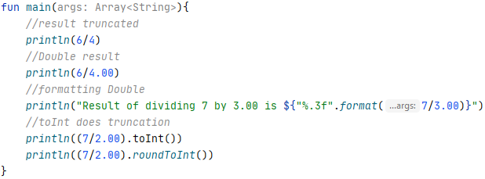
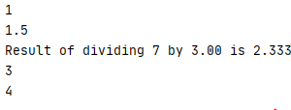
DOUBLE
Int to Double
Truncation in integer division
Double to Int
Formatting a Double
Notes:
%b Boolean
%c Character
%d Signed Integer
%e Float in Scientific Notation
%f Float in Decimal Format
%g Float in Decimal or Scientific Notation, depending on value
%h Hashcode of the supplied argument
%n Line separator
%o Octal Integer
%s String
%t Date or Time
%x Hexadecimal Integer

Slide 42
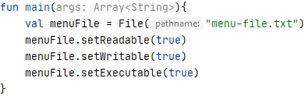
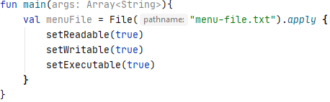
STANDARD FUNCTIONS
They are general utility functions
apply, let, run, with, also, takeIf, takeUnless
apply – series of configuration, returns the receiver

Slide 43
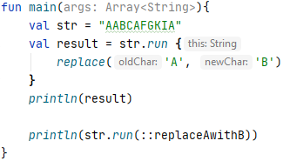
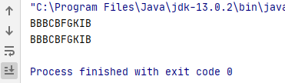
STANDARD FUNCTIONS
run – Similar to apply, but not returns the receiver
It returns the result from lambda or function.

Slide 44
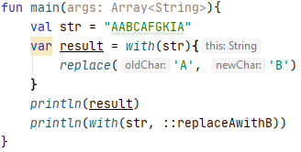
STANDARD FUNCTIONS
with – Similar to run, but in different syntax. 1st argument is the receiver. It returns the result from lambda or function.

Slide 45

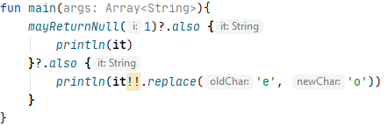

STANDARD FUNCTIONS
also – Similar to let, but returns the receiver instead of the result from lambda or function.
Try calling mayReturnNull with 3
Try replacing the lambda with a function

Slide 46

STANDARD FUNCTIONS
takeIf & takeUnless – take a condition (predicate) and return either the receiver or null when the condition is true (takeIf) or false (takeUnless)

Slide 47
LISTS
List<type>
listOf – read-only
mutableListOf – writable
toList, toMutableList – interchangeable
getOrElse, getOrNull – safe index access
add, addAll, remove, removeIf, removeAll, clear, [index] – change mutable lists, must remove the explicit List<type> in the variable declaration.
Examples on the next slide

Slide 48
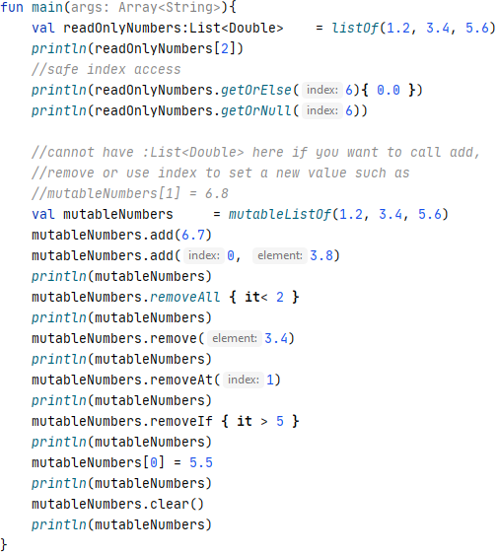
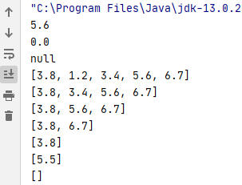
LISTS

Slide 49
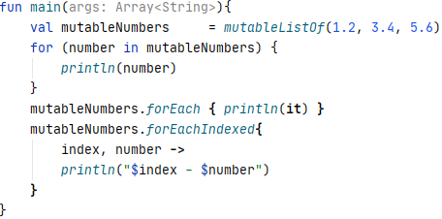
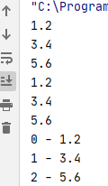
ITERATION ON LISTS
for (var in list) {code}
forEach {lambda}
forEachIndexed {lambda}

Slide 50
SETS
setOf – duplicate elements viewed as one
mutableSetOf – mutable set
contains – returns true or false
elementAt, elementAtOrElse, elementAtOrNull
size – a property not a method
shuffled, first, last, etc.
Examples on the next slide

Slide 51
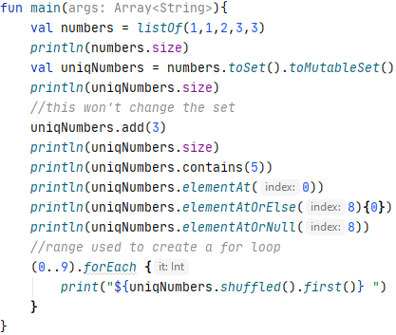
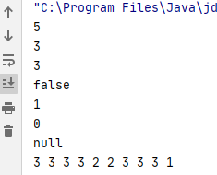
SETS
Collection Conversion

Slide 52
MAPS (DICTIONARY)
mapOf – “key to value” pairs or Pair(key, value)
mutableMapOf – mutable map
contains – takes a key and returns Boolean
get, getValue, [key], getOrElse, getOrDefault
put, getOrPut
remove, clear
+=, -=
Examples on the next slide

Slide 53
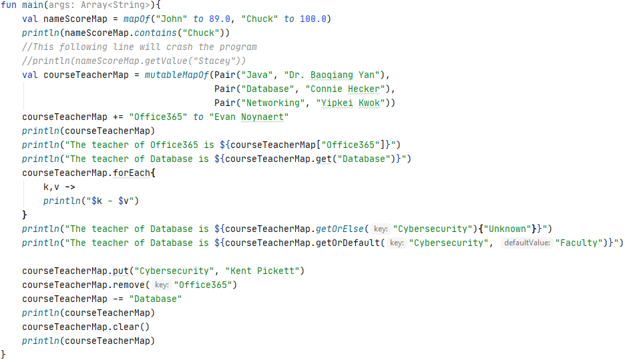
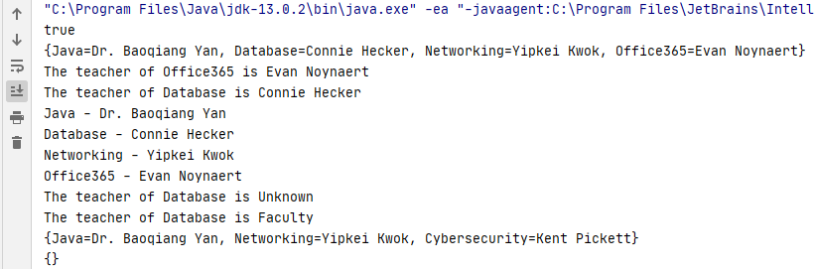
MAPS (DICTIONARY)

Slide 54
CLASSES
Defining a class – use the keyword class
Class functions – functions defined in a class
Class properties – variables in class scope
Custom getter and setter with the keyword field
Constructing instances – creating objects
Class function call – create an instance then call,
Called function must be non-private.
Examples on the next slide

Slide 55
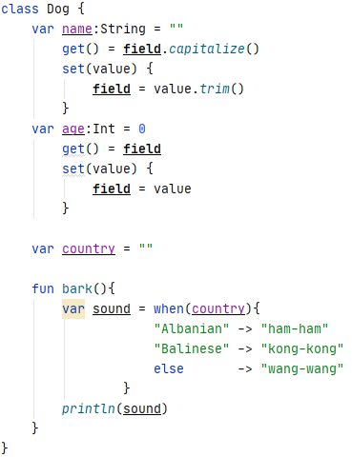
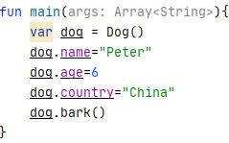

CLASS EXAMPLE

Slide 56
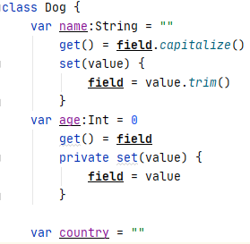

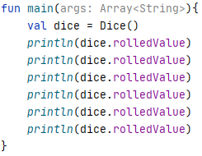

PROPERTY VISIBILITY &
COMPUTED PROPERTIES
public (default), internal (module), protected (child)
Read-only – use the keyword private for setter
Computed property – a field not generated
Calculation independent of current property value

Slide 57
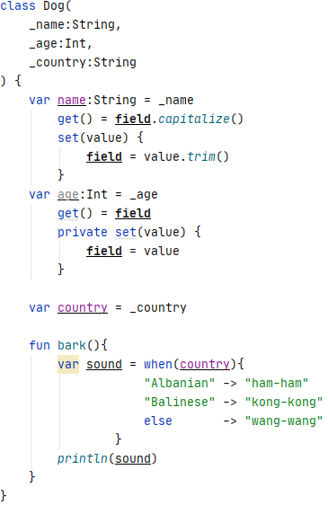
CONSTRUCTORS
All classes have a default constructor with no arguments if no explicit constructor is defined.
Primary constructors – defined after the class name within parenthesis usually with parameters.
_ is for single-use temporary variables

Slide 58

DEFINE PROPERTIES IN
PRIMARY CONSTRUCTORS
Used for properties without custom getter and setter. Can have default values.
_ removed since they are properties now instead of temporary variables
Properties with custom getter or setter cannot be defined here.

Slide 59


SECONDARY CONSTRUCTORS
Defined using the keyword constructor
Returns an object created by calling the primary constructor using the keyword this
May also have default values for the parameters.
Named arguments

Slide 60



INITIALIZER BLOCKS
Defined using the keyword init
Can be used to perform data validation, etc.

Slide 61

LATE INITIALIZATION
Keyword – lateinit
Declare a variable first without initialization
Initialization not happen until a value is assigned
Useful when you have no control on the lifecycle
Not allowed for primitive data or non-nullable objects

Slide 62

LAZY INITIALIZATION
Syntax – replace assignment with
by lazy [(lazy thread option)] { lambda }
Initialization not happen until accessed to prevent unnecessary initialization of objects
Useful in multithread environment

Slide 63
INHERITANCE
Mark a class inheritable with keyword open
Declare a class as a subtype with :SuperClass
Constructor call after :SuperClass as needed
Mark functions overridable with keyword open
Properties are also overridable. super is used to access parent class’s properties.
protected properties or functions only usable by this class and its subclasses.

Slide 64




INHERITANCE
Cannot be called outside the class hierarchy
Used to access super class’s properties or functions.
Type Checking

Slide 65


THE ANY CLASS AND
TYPE CASTING
Any – common super class, like Object in Java
Casting – convert an object to another type
Like Polymorphism in Java
Safe to do a type checking before casting.

Slide 66



SINGLETON – OBJECT
DECLARATION
Mark a singleton “class” with keyword object
Constructor not allowed for objects, init block is used for a one-time initialization
The initialization not happen until referenced.

Slide 67


OBJECT EXPRESSION
Anonymous singleton subclass that can be assigned to a “variable”.
Overriding still allowed

Slide 68



COMPANION OBJECTS
Singleton object shared by instances of the host class. Initialized when the first instance is created.

Slide 69



NESTED CLASSES
Usually non-public, otherwise a normal class

Slide 70



DATA CLASSES
At least one primary constructor parameter, no fun
Default implementations for toString, equals, copy, hashCode only respect the primary parameters.
Try hashCode
Not “centimeter” but “Meter”. Only primary parameter updated.

Slide 71



DE-STRUCTURING
DECLARATIONS
Data split into multiple var’s or val’s
Data class provides de-structuring by default.
de-structuring via
component operators

Slide 72



ENUMERATED CLASSES
enum – constants separated by commas
Enum constructor – tied to use a value for update
Requires each enum value to have a parameter of this type
Usually has a function that uses the constructor parameter to update the passed argument’s state. Here it returns a coordinate object.

Slide 73




OPERATOR OVERLOADING
Common operator symbols used instead of fun call

Slide 74


OPERATOR OVERLOADING
Common operator symbols used instead of fun call

Slide 75



OPERATOR OVERLOADING
Common operator symbols used instead of fun call

Slide 76


OPERATOR OVERLOADING
Common operator symbols used instead of fun call
The names of the functions to overload are fixed and listed on the previous three slides.

Slide 77






INTERFACE
interface – keyword
Implementing interface – override properties, funs
No initializer allowed, but default getter is OK.

Slide 78






INTERFACE
Default implementations

Slide 79




ABSTRACT CLASSES
Keyword – abstract for both properties and funs
Abstract class may have non-abstract functions

Slide 80



GENERICS
Used as container of a collection of Any objects

Slide 81




MULTIPLE GENERIC TYPES
Use different letters within <>
Use <T:Fruit> to limit items to Fruit
Function parameter or lambda

Slide 82


VARARG AND GET
The args are viewed as an array. Get needs index.
operator overloading
out is required for vararg, see next slide

Slide 83



IN AND OUT
<out T> – only used as return type
<in T> – only used as parameter/input type
<T> – used as both return and input
Be cautious when using interface with out or in types that belong in the same class hierarchy. See next slide.

Slide 84




IN AND OUT
There is a class hierarchy whose members can be specified as either in or out in generic interfaces.
There are different classes implementing these in or out interfaces, focusing different classes in the hierarchy.

Slide 85




IN AND OUT
For 'out' generic, we could assign a class of subtype to class of super-type
For ‘in' generic, we could assign a class of super-type to class of subtype

Slide 86

ANNOTATION
Attach metadata to code
Annotation Declaration – annotation class
@Target – elements annotatable using this class
Typically you only use the annotation provided by third party library providers.

Slide 87
EXTENSION
Add functions/properties to classes you don't own.
Add "non-core" functions/properties to own classes
Usable on nullable objects/values
Extension lambda – extending the class of the object in parenthesis with a lambda.

Slide 88

LABELLED BREAK
Use label@ syntax to label a loop that you want the break statement to break.
Useful when you try to break outer loop from an inner loop.

Slide 89
PAIRS
Map entries are pairs.
The keyword is to
The key/value can be anything.
Can also be used to return multiple values at the same time.
Support data de-structuring automatically

Slide 90




SINGLE ABSTRACT METHOD
(SAM)
If an interface only has one abstract method, the call to functions that takes an object of this type can be simplified.
Used to call Java Functional Interfaces from Kotlin

